Slide 1
GRADE 7 ACCELERATED · UNIT 3 · THREAD A · DAY 1
Exponent Laws with Variable Bases
MA.8.AR.1.1
I can multiply and divide monomials, and raise a monomial to a power, by applying the laws of exponents to variable bases.
Grade 7 Accelerated · Unit 3 · Thread A · Day 1 — Exponent Laws with Variable Bases
1

Slide 2
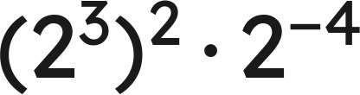
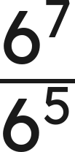
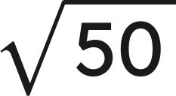

Warm-Up
1. Find the value:
2. Write as one power:
3.
is between which two whole numbers?
4. Write with an exponent:
Grade 7 Accelerated · Unit 3 · Thread A · Day 1 — Exponent Laws with Variable Bases
2

Slide 3

Warm-Up
1. Find the value:
4
2. Write as one power:
6² = 36
3.
is between which two whole numbers?
7 and 8
4. Write with an exponent:
Grade 7 Accelerated · Unit 3 · Thread A · Day 1 — Exponent Laws with Variable Bases
3

Slide 4


Notes
I. Product of powers — the base is a letter now
Multiply the coefficients. Add the exponents of like bases.
Different variables stay separate:
Grade 7 Accelerated · Unit 3 · Thread A · Day 1 — Exponent Laws with Variable Bases
4

Slide 5



Notes
II. Power of a power, power of a product
Power of a power: multiply the exponents. Power of a product: raise every factor.
Grade 7 Accelerated · Unit 3 · Thread A · Day 1 — Exponent Laws with Variable Bases
5

Slide 6
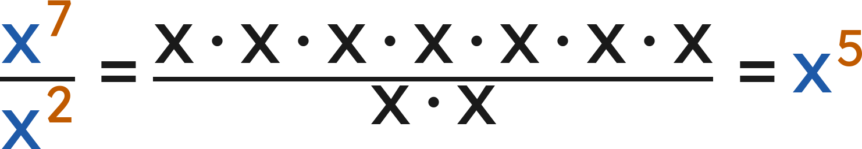
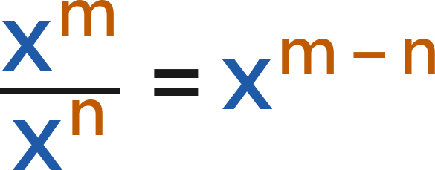
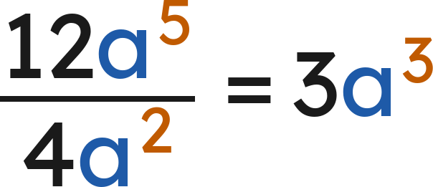
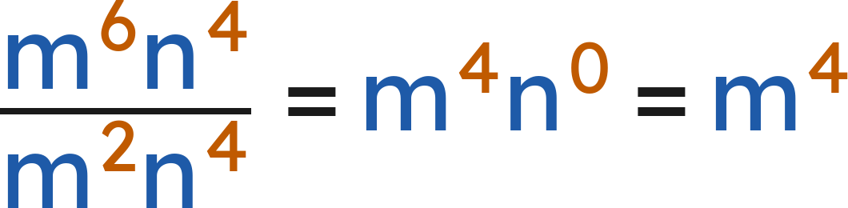
Notes
III. Quotient of powers — dividing monomials
Divide the coefficients. Subtract the exponents of like bases.
Grade 7 Accelerated · Unit 3 · Thread A · Day 1 — Exponent Laws with Variable Bases
6

Slide 7
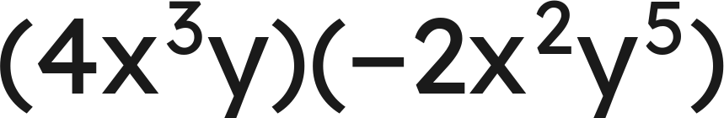
Example 1
Write an equivalent expression as a single monomial.
Grade 7 Accelerated · Unit 3 · Thread A · Day 1 — Exponent Laws with Variable Bases
7

Slide 8
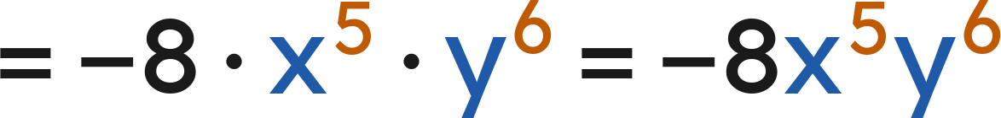
Example 1
Answer: −8x⁵y⁶
Grade 7 Accelerated · Unit 3 · Thread A · Day 1 — Exponent Laws with Variable Bases
8

Slide 9
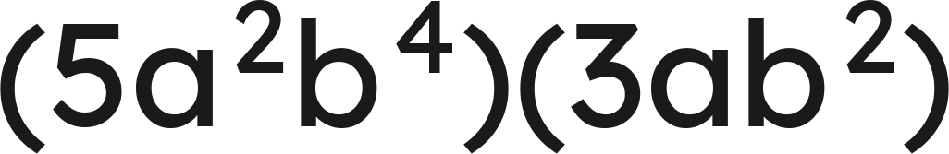
Your Turn
Write an equivalent expression as a single monomial.
Grade 7 Accelerated · Unit 3 · Thread A · Day 1 — Exponent Laws with Variable Bases
9

Slide 10
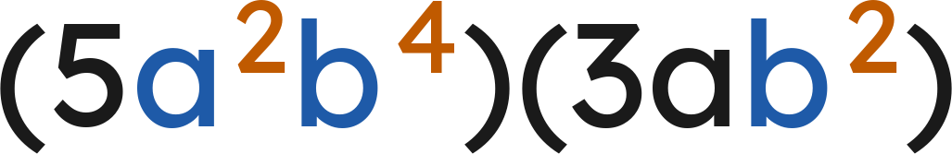



Your Turn
Write an equivalent expression as a single monomial.
Numbers:
The a's:
The b's:
Answer: 15a³b⁶
Grade 7 Accelerated · Unit 3 · Thread A · Day 1 — Exponent Laws with Variable Bases
10

Slide 11
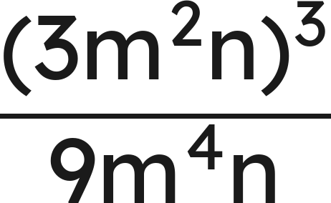
Example 2
Write an equivalent expression as a single monomial.
Grade 7 Accelerated · Unit 3 · Thread A · Day 1 — Exponent Laws with Variable Bases
11

Slide 12

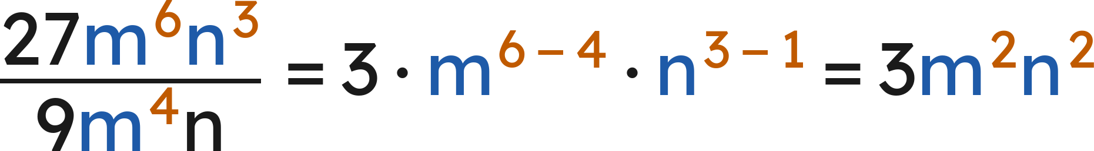
Example 2
Answer: 3m²n²
Grade 7 Accelerated · Unit 3 · Thread A · Day 1 — Exponent Laws with Variable Bases
12

Slide 13
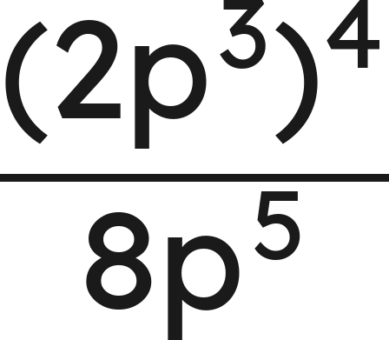
Your Turn
Write an equivalent expression as a single monomial.
Grade 7 Accelerated · Unit 3 · Thread A · Day 1 — Exponent Laws with Variable Bases
13

Slide 14
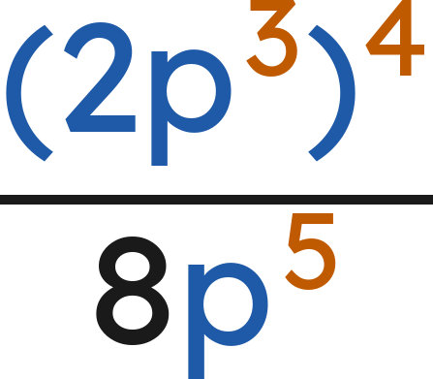



Your Turn
Write an equivalent expression as a single monomial.
Top first:
Numbers:
The p's:
Answer: 2p⁷
Grade 7 Accelerated · Unit 3 · Thread A · Day 1 — Exponent Laws with Variable Bases
14

Slide 15

Whiteboards · Question 1 of 9
Answer it.
Grade 7 Accelerated · Unit 3 · Thread A · Day 1 — Exponent Laws with Variable Bases
15

Slide 16



Whiteboards · Question 1 of 9
Answer:
Grade 7 Accelerated · Unit 3 · Thread A · Day 1 — Exponent Laws with Variable Bases
16

Slide 17
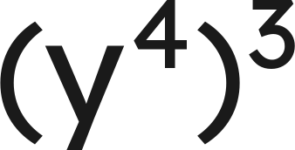
Whiteboards · Question 2 of 9
Answer it.
Grade 7 Accelerated · Unit 3 · Thread A · Day 1 — Exponent Laws with Variable Bases
17

Slide 18



Whiteboards · Question 2 of 9
Answer:
Grade 7 Accelerated · Unit 3 · Thread A · Day 1 — Exponent Laws with Variable Bases
18

Slide 19


Whiteboards · Question 3 of 9
A cube has edges
centimeters long.
Its surface area is
square centimeters.
What is the volume of the cube, in cubic centimeters?
Answer it.
Grade 7 Accelerated · Unit 3 · Thread A · Day 1 — Exponent Laws with Variable Bases
19

Slide 20


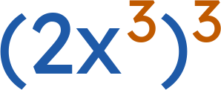


Whiteboards · Question 3 of 9
A cube has edges
centimeters long.
Its surface area is
square centimeters.
What is the volume of the cube, in cubic centimeters?
Volume = edge × edge × edge:
Answer:
Grade 7 Accelerated · Unit 3 · Thread A · Day 1 — Exponent Laws with Variable Bases
20

Slide 21
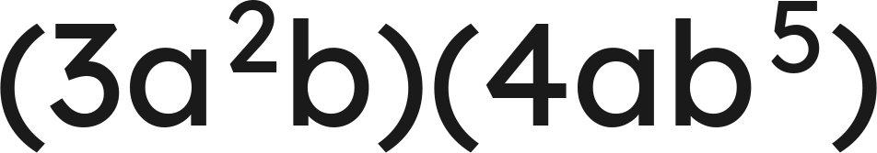
Whiteboards · Question 4 of 9
Answer it.
Grade 7 Accelerated · Unit 3 · Thread A · Day 1 — Exponent Laws with Variable Bases
21

Slide 22
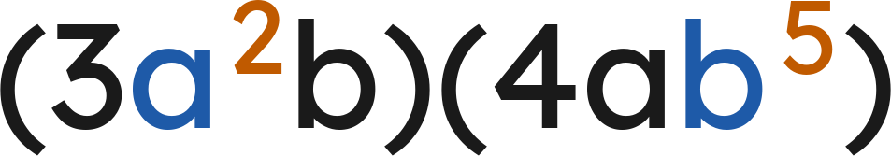



Whiteboards · Question 4 of 9
Numbers:
The a's:
The b's:
Answer:
Grade 7 Accelerated · Unit 3 · Thread A · Day 1 — Exponent Laws with Variable Bases
22

Slide 23
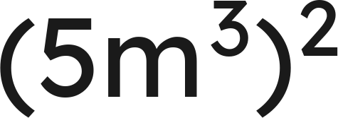
Whiteboards · Question 5 of 9
Which expression is equivalent?
A. 25m⁶
B. 10m⁶
C. 25m⁵
D. 5m⁶
Answer it.
Grade 7 Accelerated · Unit 3 · Thread A · Day 1 — Exponent Laws with Variable Bases
23

Slide 24

Whiteboards · Question 5 of 9
Which expression is equivalent?
Answer: A — 25m⁶
Grade 7 Accelerated · Unit 3 · Thread A · Day 1 — Exponent Laws with Variable Bases
24

Slide 25
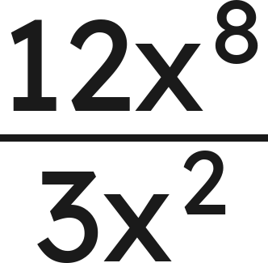
Whiteboards · Question 6 of 9
Which expression is equivalent?
A. 4x¹⁰
B. 4x⁶
C. 9x⁶
D. 4x⁴
Answer it.
Grade 7 Accelerated · Unit 3 · Thread A · Day 1 — Exponent Laws with Variable Bases
25

Slide 26
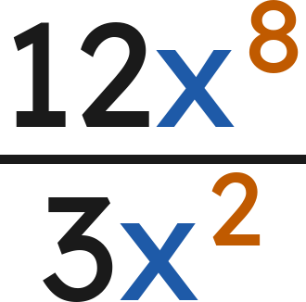


Whiteboards · Question 6 of 9
Which expression is equivalent?
Numbers:
The x's:
Answer: B — 4x⁶
Grade 7 Accelerated · Unit 3 · Thread A · Day 1 — Exponent Laws with Variable Bases
26

Slide 27
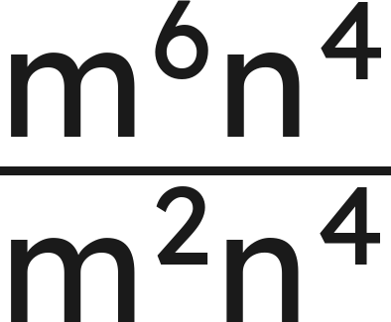
Whiteboards · Question 7 of 9
Answer it.
Grade 7 Accelerated · Unit 3 · Thread A · Day 1 — Exponent Laws with Variable Bases
27

Slide 28
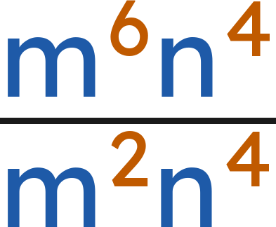

Whiteboards · Question 7 of 9
The m's:
The n's:
Answer:
Grade 7 Accelerated · Unit 3 · Thread A · Day 1 — Exponent Laws with Variable Bases
28

Slide 29


Whiteboards · Question 8 of 9
Find the value of
:
Answer it.
Grade 7 Accelerated · Unit 3 · Thread A · Day 1 — Exponent Laws with Variable Bases
29

Slide 30



Whiteboards · Question 8 of 9
Find the value of
:
Same base, so the exponents add:
Answer: n = 8
Grade 7 Accelerated · Unit 3 · Thread A · Day 1 — Exponent Laws with Variable Bases
30

Slide 31
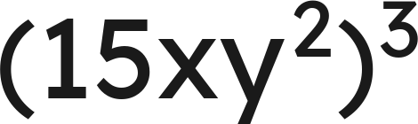
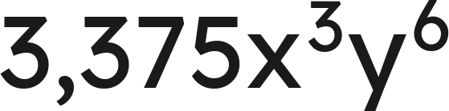
Whiteboards · Question 9 of 9
Rachel writes
as
.
Justina writes it as
. Who is correct? Explain.
Write your answer in sentences.
Grade 7 Accelerated · Unit 3 · Thread A · Day 1 — Exponent Laws with Variable Bases
31

Slide 32
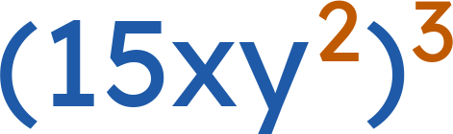
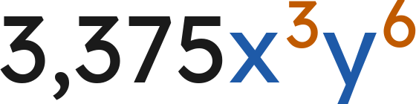



Whiteboards · Question 9 of 9
Rachel writes
as
.
Justina writes it as
. Who is correct? Explain.
Answer: Both are correct; 15³ = 3,375, x · x · x = x³, and six y's make y⁶.
Grade 7 Accelerated · Unit 3 · Thread A · Day 1 — Exponent Laws with Variable Bases
32

Slide 33

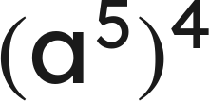
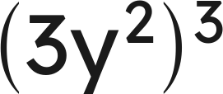
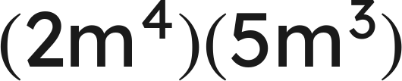
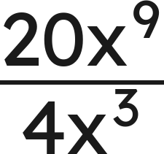


Independent Set
1.
Write as one power.
2.
Write as a single monomial.
3.
Write as a single monomial.
4.
Write as a single monomial.
5.
Write as a single monomial.
6.
Find the value of
.
Grade 7 Accelerated · Unit 3 · Thread A · Day 1 — Exponent Laws with Variable Bases
33

Slide 34
IXL
1.
Open IXL and start today's skills.
2.
Work on paper where the question needs work. The answer box does not show it.
3.
Every skill listed is required, to a SmartScore of 67. Due at the start of the next class.
Today's skills — all required
Multiply powers: variable bases — TR9
Powers of a power: variable bases — 2CU
Divide monomials with positive exponents — C8L
Grade 7 Accelerated · Unit 3 · Thread A · Day 1 — Exponent Laws with Variable Bases
34

